Slide 1
Organic Chemistry
Introduction

Slide 2
Introduction to organic chemistry
Organic Chemistry is the branch of chemistry dealing with organic compounds.
Organic compounds are those compounds which are generally found or derived from living organisms.
Almost all organic compounds consist of carbon.
Infact, all the compounds of carbon are considered organic with the exception of carbon dioxide, carbonic acid and carbides which are considered as inorganic compounds.

Slide 3
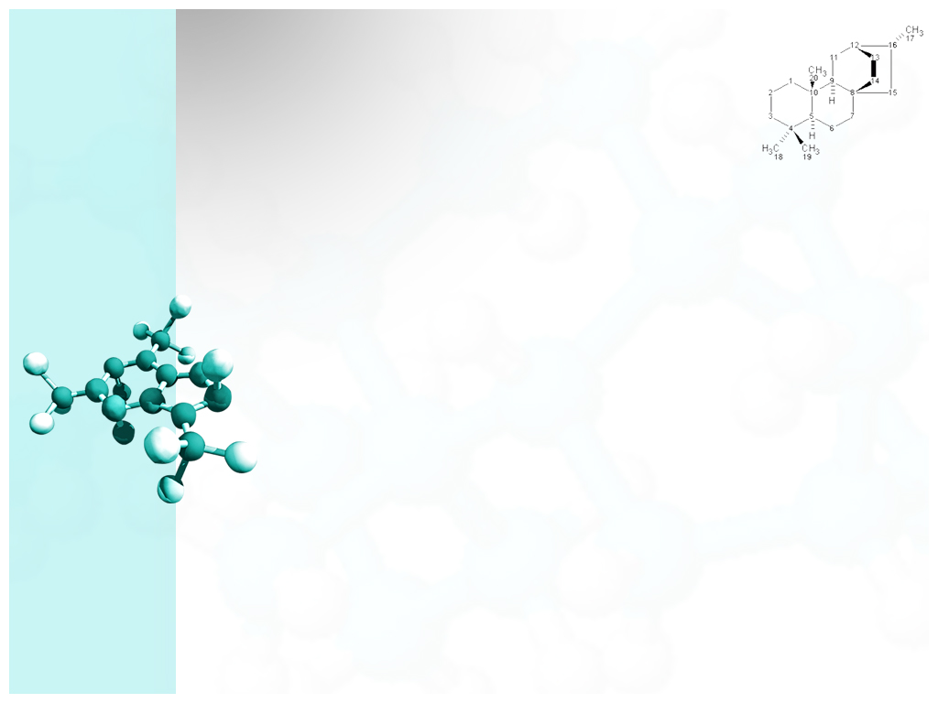
Birth of organic chemistry
Earlier it was believed that organic compounds can only be obtained from living organisms and cannot be synthesized in the laboratory.
In 1805 ,a Swedish chemist, Berzilius proposed vital force theory according to which organic compounds are made from vital forces , therefore they could not be synthesized in laboratory
In 1823, Fredrick Wohler, synthesized urea from ammonium cyanate without any physiological process of living organism. Urea is the organic compound found in urine of living organisms.

Slide 4
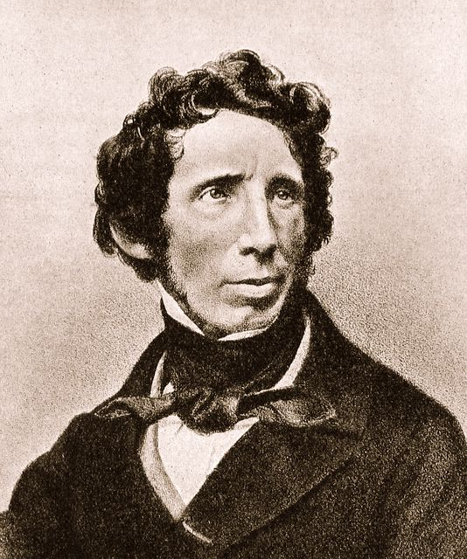
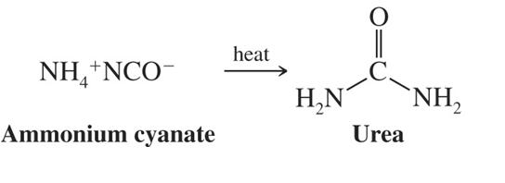
Fredrick Wohler
Synthesis of urea

Slide 5
The synthesis of urea gave a big setback to vital force theory
Later on other organic compounds like acetic acid, ethyl alcohol, methane were synthesized in the laboratory.
These synthesis confirmed that no such vital force was needed to synthesize organic compounds.
In modern times many such organic compounds which are found in living organisms are synthesized.
Many organic compounds possessing complicated structure have also been synthesized.
“Organic Synthesis” is the branch of organic chemistry dealing with synthesis of organic compounds.

Slide 6
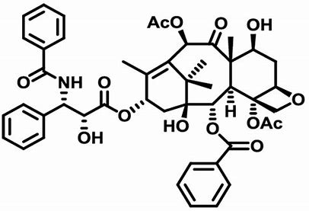
Taxol
This was one of the most promising medicine for treatment of ovarian and breast cancer
Treatment of one cancer patient required cutting three 100 year old Taxus brevifolia
This compound was synthesized in 1994 independently by two research groups illustrating power of modern organic synthesis.

Slide 7
Organic Chemistry as a seprate branch
Organic compounds significantly differ from inorganic compounds in the following aspects
Number-The number of organic compounds found in nature or prepared synthetically is much more than number of inorganic compounds.
Complexity-The molecule of organic compounds is generally more complex than inorganic molecule.
Isomerism-Many molecules have same molecular formula yet they are not identical. This is known as isomerism and is more common in organic compounds.
Therefore it is more logical to deal with organic compounds as a seprate branch because they show properties and behaviour not shown by others.

Slide 8
Unique property of carbon and large number of organic compounds
Carbon has a unique property to bind with itself and form a large chain or ring. This property is known as concatenation.
This is the reason behind existence of organic compounds in large numbers and possessing complex structure.
Carbon can bind with itself to form straight linear chain, branched chain, ring or structures having chains and rings.
Many compounds of carbon have same molecular formula but different structural formula or arrangement of atoms giving rise to isomerism.

Slide 9
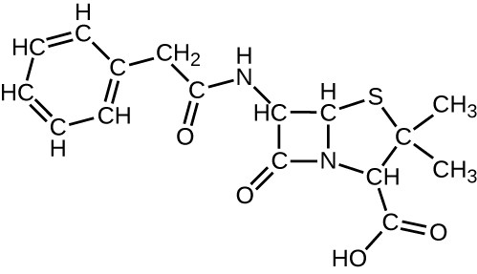
Penicillin G
This is the molecule comprising of both chain and ring

Slide 10
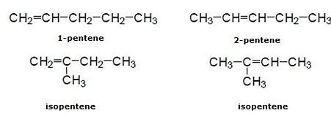
Isomerism
These compounds have same molecular formula C5H10 but they are not identical due to different structural formula. Hence they are called isomers.

Slide 11
THANK YOU!

